Slide 1
Booleans, Logic, & Conditional “if” Statements.
Week 3 | Lecture 1 (3.1)
While waiting, open the Jupyter Notebook for today’s lecture
Upcoming
Lab 1 Due 11:59 pm Friday.
Lab 2 Released Thursday 6:00 pm.
Reflection 3 Released Friday 6:00 pm.
Tutorial and Practical sessions (in-person AND online) running all week.

Slide 2
This Week’s Content
Lecture 3.1
Booleans, Logic, & Conditional if Statements
Lecture 3.2
String Comparisons and More on if Statements
Lecture 3.3
Design Problem: Rock, Paper, Scissors, Lizard, Spock!

Slide 3
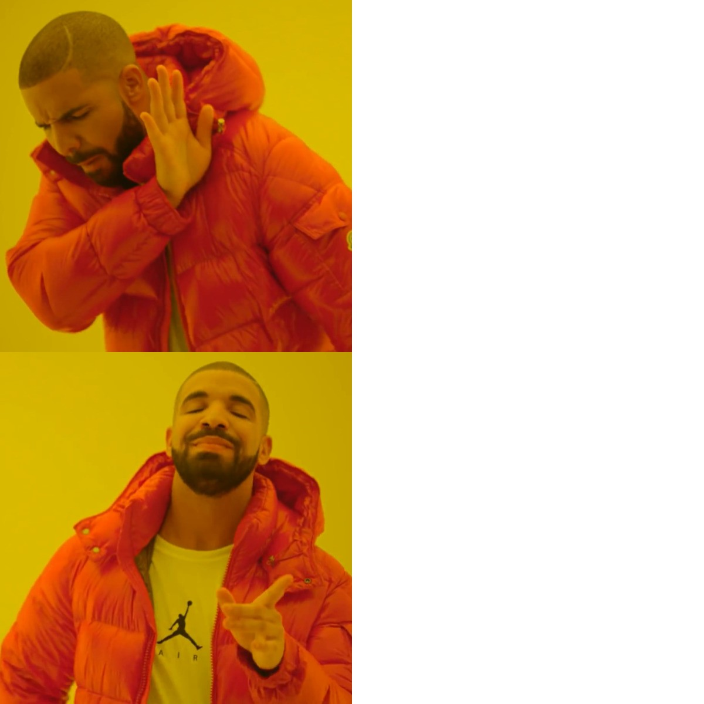
Online Tutorials and Labs
These times worked best for you!
TIP FOR SUCCESS: Put these in your calendar! Labs are due Friday night!
Schedule and Zoom Links are on Quercus
“Tutorial Homepage”
“Lab Homepage”
Commuting
 | Time
Tutorial | Thursday 5 PM to 6 PM
Lab | Tuesday 6 PM to 8 PM
Lab | Friday 6 PM to 8 PM
Online Tutorials & Labs

Slide 4
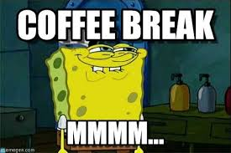
Coffee Break with a TA!
Extra help hours!
TIP FOR SUCCESS: Put in calendar, treat as a scheduled class
Schedule and Zoom Links are on Quercus
”Coffee Break (Office Hours)”
Office Hours
TA | Time | Mode
Michael Tisi | Monday 12 PM to 1 PM | Online
Ali Tohidifar | Monday 6 PM to 7 PM | Online
Behrang Mohajer | Tuesday 11 AM to 12 PM | Online
Tamara Kecman | Thursday 11 AM to 12 PM | Online
Daniel Tovbis | Thursday 3 PM to 4 PM | In-person
Coffee Break

Slide 5
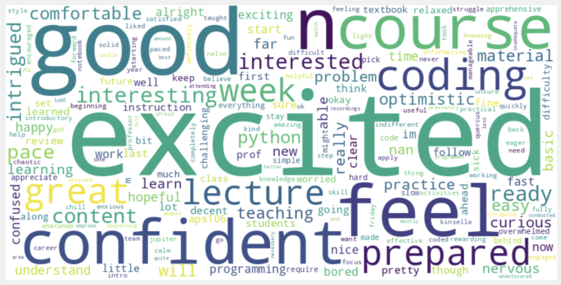
One Word on APS106

Slide 6
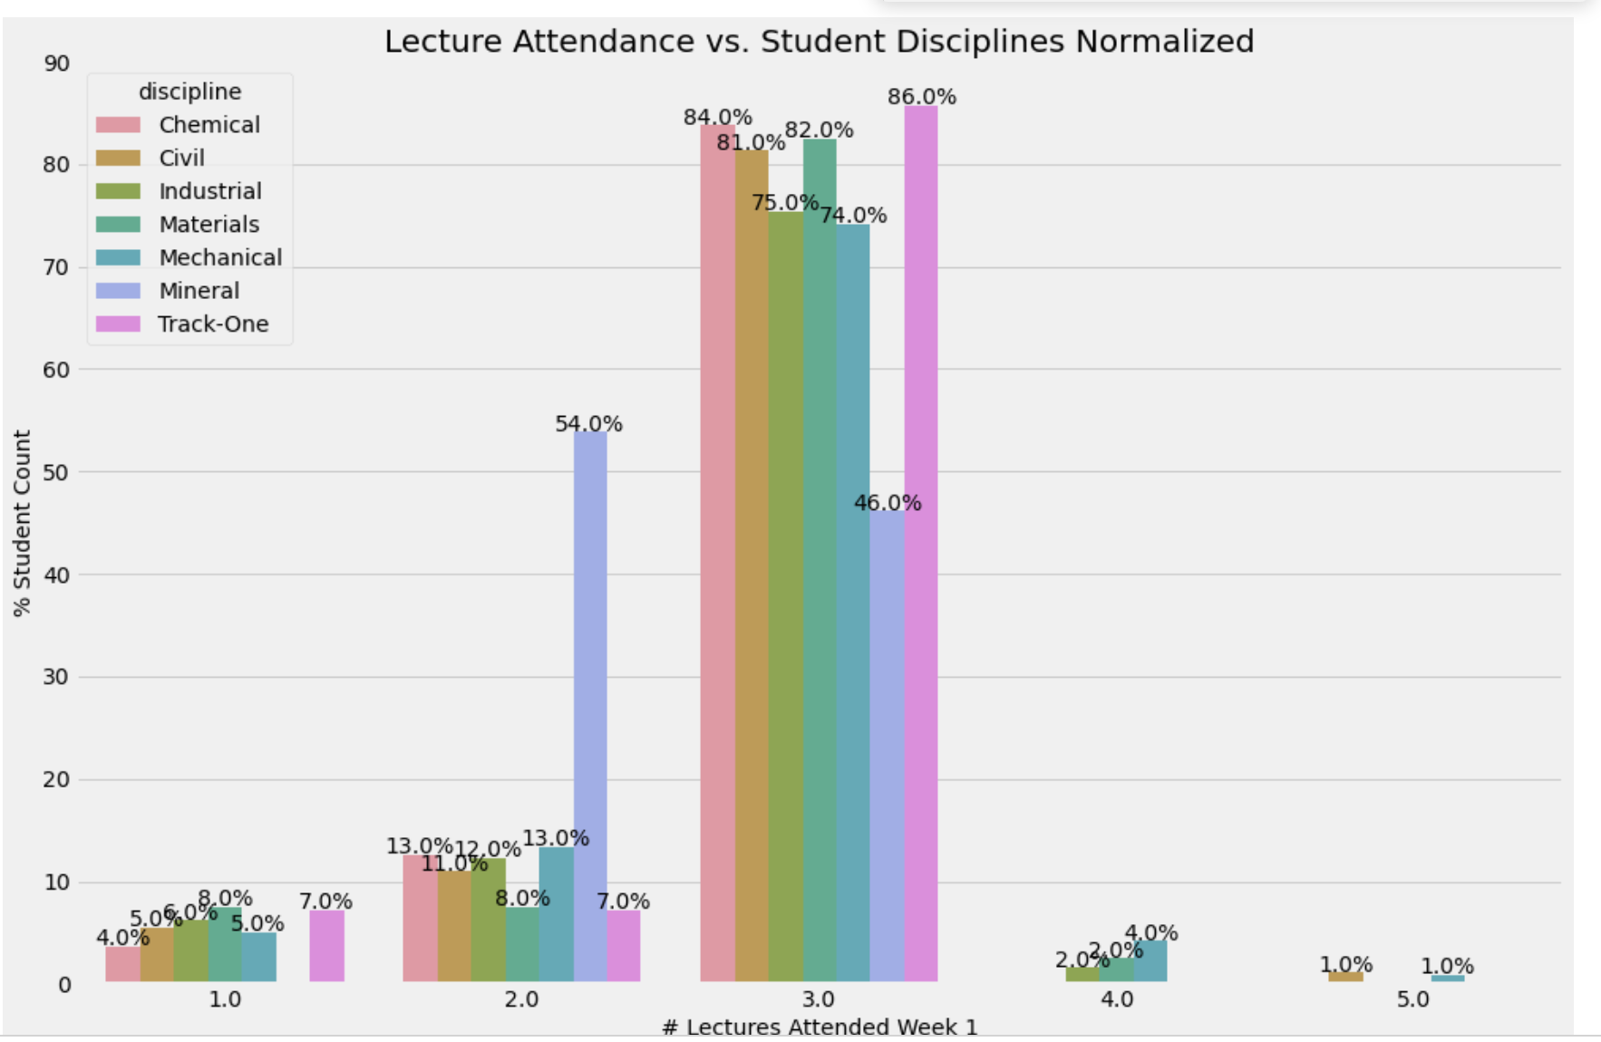
Attendance by Discipline

Slide 7
Common Reflection Insights & Feedback
If one concept confuses me in lecture, it piles up and it is hard to keep up
Slow down typing code and jumping between slides and notebooks
Do more breakout coding sessions and practice in lecture
Bigger font size when coding
It can be hard to hear over the talking in Myhal 150
Teaching team walking around during lecture is helpful

Slide 8

Making Choices
statements
Sequential structure
statements
Conditional structure
True
condition
statements
statements
statements
False
statements
Notes:
Sequential is what we’ve seen so far, everything runs in order that Python sees it, just like a book.
Now we’re going to enter the land of conditions, kind of like those choose your own adventure books or games now, where you can have multiple paths that produce different outputs!
Before we get into how to write these conditions, we have to understand logic, and how computers interpret this concept of True and False.

Slide 9
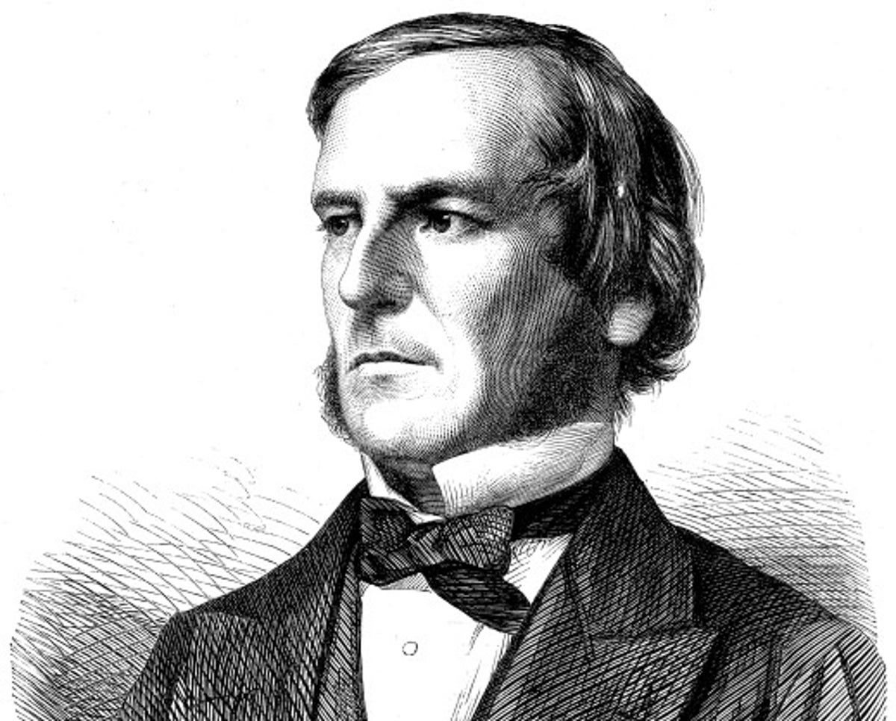
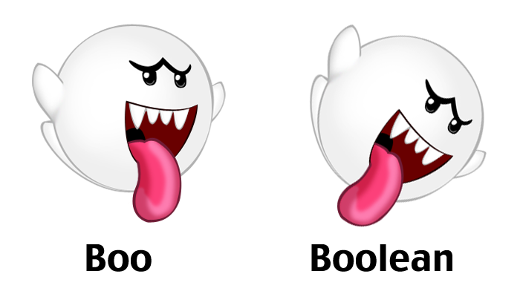
Boolean Type (bool)
Named after George Boole (mid-1800s)
Boolean algebra and Boolean logic
Laid the foundation for information age and computer science
Python type bool has only two possible values: True and False
>>> state = True
>>> state
True
>>> state = False
>>> state
False
“bool” is a sub-type of “int”, where True == 1, False == 0
Notes:
Note the special values of True and False, I don’t need quotes around them to show Python it is a string, because it’s not. True and False are special values in python that represent exactly what you might think, either a statement is True, or False.
Now when I said that it laid the foundation for information age, which really just means technology and computer science, can anyone guess or tell me why this simple True/False logic helped advance our technology so much?
Correct! The 1s and 0s of machine code!

Slide 10
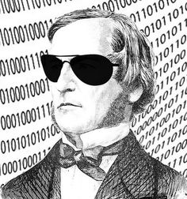

Boolean Example / “Wordle” Break
Crack the code!
Cool Boole
6 | 8 | 2
One number is correct and well placed
6 | 1 | 4
One number is correct but wrong place
2 | 0 | 6
Two numbers are correct but wrong places
7 | 3 | 8
Nothing is correct
CODE
8 | 7 | 0
One number is correct but wrong place
Notes:
Make sure everyone gets what to do

Slide 11
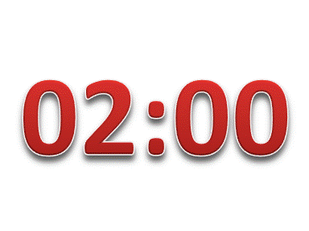
Boolean Example / “Wordle” Break
Crack the code!
6 | 8 | 2
One number is correct and well placed
6 | 1 | 4
One number is correct but wrong place
2 | 0 | 6
Two numbers are correct but wrong places
7 | 3 | 8
Nothing is correct
CODE
8 | 7 | 0
One number is correct but wrong place

Slide 12

Boolean Example / “Wordle” Break
Crack the code!
6 | 8 | 2
One number is correct and well placed
6 | 1 | 4
One number is correct but wrong place
0 | 4 | 2
2 | 0 | 6
Two numbers are correct but wrong places
7 | 3 | 8
Nothing is correct
CODE
8 | 7 | 0
One number is correct but wrong place
Notes:
Nice! For those that didn't get it, I know you would have given more time. This was an example of some boolean logic, because you knew some variables were True, or False. You used true false, yes no, logic to narrow down what the answer was.

Slide 13
Relational Operators
Relational (or comparison) operators take two values (examples: int, float, str) and produce a bool value (True or False)
Description | Operator | Example | Result
Less than | < | 3<4 | True
Greater than | > | 3>4 | False
Equal to | == | 3==4 | False
Less than or equal to | <= | 3<=4 | True
Greater than or equal to | >= | 3>=4 | False
Not equal to | != | 3!=4 | True
Boolean Expressions
Boolean Values
Python uses == for equality, because = is used for assignment

Slide 14
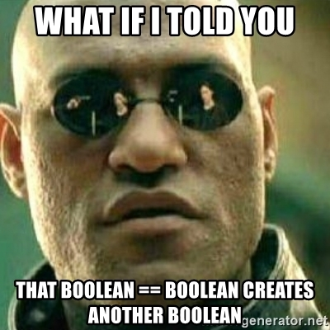
Using Python as your (bool) Calculator
Let’s take a look at how this works in Python!
Boolean type
Relational (or comparison) operators
Open your notebook
Click Link:
1. Introducing Booleans
Notes:
Our first breakout coding session that we’ll do together. We’re going to do this a few times today.

Slide 15
Logical Operators
Take Boolean operands and evaluate to Boolean values
expr1 | expr2 | expr1 and expr2 | expr1 or expr2 | not expr1
True | True | True | True | False
True | False | False | True | False
False | True | False | True | True
False | False | False | False | True

Slide 16
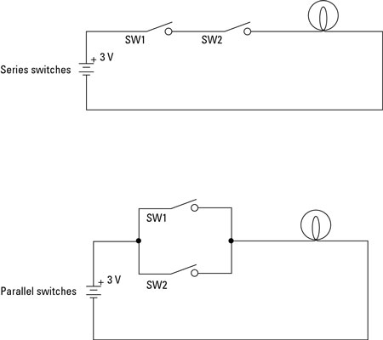
The and Operator
Binary operator
The expression left and right produces:
True if both left and right are True
False otherwise
Switch 1 AND Switch 2 must be on for light to turn on

Slide 17
The or Operator
Binary operator
The expression left or right produces:
True if either left or right are True
False only if both are False
Switch 1 OR Switch 2 must be on for light to turn on

Slide 18
The not Operator
not Binary operator (see what I did there?)
Results in a Boolean value which is the opposite of the operand value
An expression involving not produces:
True if the original value is False
False if the original value is True

Slide 19
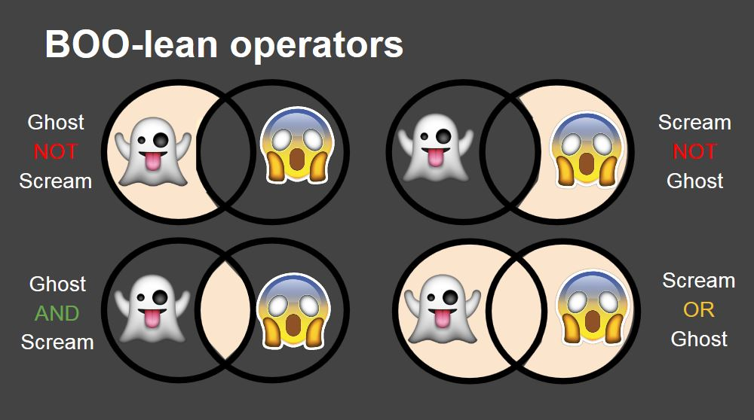

Slide 20
Order of Precedence
We can override precedence with brackets
In general, brackets should be added to make things easier to read and understand
Operator
Precedence
not
highest
and
or
lowest
Notes:
READ SLIDE
Ultimately, while it might get natural with practice over time, you don’t want to have to keep trying to think while debugging which comes first in order of precedence, whether it’s for arithmetic (addition, exponentiation, negation, etc.) or logical operators (ands and ors). Brackets will save you, and anyone reading your code, a lot of time and headaches.

Slide 21
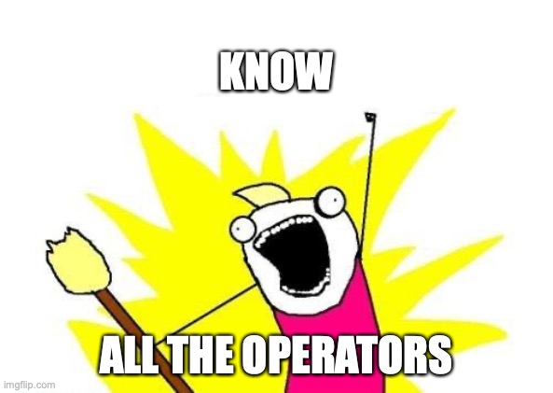
All the Operators!
Arithmetic (+, -, /, etc.)
Relational (<, ==, etc.)
Logical/Boolean (not, and, or)
Precedence when combining
Arithmetic operators have higher precedence than relational operators
Relational operators have higher precedence than Logical/Boolean operators
All relational operators have the same precedence (i.e. read left to right)

Slide 22
Coding Time!
Let’s go experiment with some of what we just saw
Logical operators (and, or, not)
Order of precedence
Open your notebook
Click Link:
2. Logical Operators

Slide 23
Binary Operators
Rules for evaluation
Evaluate the left operand (i.e. expression) to a value and replace that operand expression with that value POSSIBLE SHORT CIRCUIT
Evaluate the right operand (i.e. expression) to a value and replace that operand expression with that value
Apply the operator to the two resultant values

Slide 24
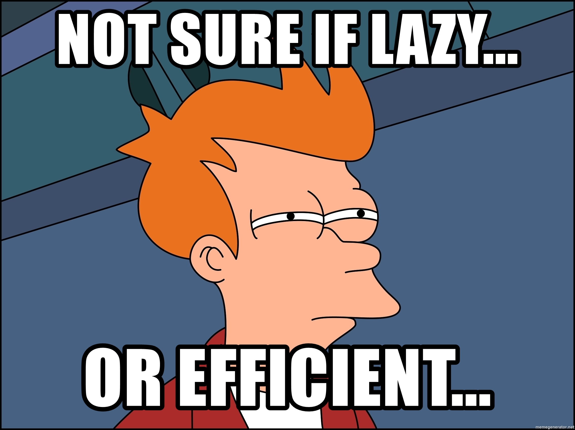
Short-Circuit (Lazy) Evaluation
or evaluates to True iff at least one operand is True
operand_1 or operand_2
If the operand_1 is True, operand_2 will not be checked!
and evaluates to False iff at least one operator is False
operand_1 and operand_2
If the operand_1 is False, the operand_2 will not be checked!
Like how in a Multiple-Choice Question, if you for sure know the answer is A, you can save time not reading B, C, and D!

Slide 25
Coding Time!
Let’s go experiment with some of what we just saw
Short-circuit (lazy) evaluation
Open your notebook
Click Link:
3. Lazy Evaluation

Slide 26

Making Choices
statements
Sequential structure
statements
Conditional structure
?
True
condition
statements
statements
statements
False
statements
Notes:
Back to our first slide, now we know how to represent True and False in programming, but how do we represent this condition? This way to be able to have multiple pathways in our code

Slide 27
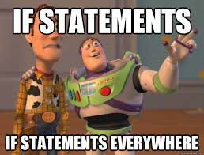

The if statement
A general form of an if statement is as follows:
The “body” only executes if the if statement is True
if statements are always followed by a colon (:)
This is how Python knows you are creating a new block of code
Indenting four spaces tells Python what lines of code are in that block
if expression:
body

Slide 28
if Statement Example
grade = 51
if grade < 50:
print(“You failed APS106…”)
if grade >= 50:
print(“Hooray you passed!”)
Hooray you passed!
Notes:
What will this output?

Slide 29
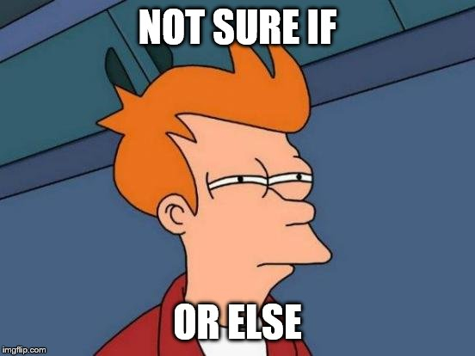
Adding the else statement
A more general form of the if conditional statement is:
ONLY 1 of body1 or body2 will be executed.
if statement is True, executes body1
if statement is False, executes body2
if expression:
body1
else:
body2
Notes:
What if we wanted a way to say if something is true, do one thing, but if it's ANY other case, do something else. We don't want to necessarily have to account for each specific case, we just want, true do one thing, false do another thing.

Slide 30
if-else Statement Example
grade = 51
if grade <= 50:
print(“You failed APS106…”)
else:
print(“Hooray you passed!”)
Hooray you passed!

Slide 31
Let’s Code!
Let’s go experiment with some of what we just saw
if statements
Using the else keyword
Open your notebook
Click Link:
4. Introducing if statements

Slide 32
Booleans, Logic, & Conditional “if” Statements.
Week 3 | Lecture 1 (3.1)

